Slide 1


Slide 2

Major Project-I (01CE0716)
Review 2 (23/08/2025)
Deepfake Detection in images using ML
Team ID: 7CE_169
Team Member 1: Pradip Chavada (92310103082) (7TC1)
Team Member 2: Yashkumar Mayani (92310103058) (7TC1)
Guided By
Internal Guide Name: Prof. Reshma Sunil
Department of Computer Engineering, Faculty of Engineering & Technology

Slide 3
Outline
Abstract
Introduction
Problem Statement
Literature Review
System Requirements
Dataset Overview
Preprocessing Pipeline
Methodology
Models Overview
Observation
Challenges
Conclusion
References

Slide 4
Abstract
This study compares five Convolutional Neural Network (CNN) architectures ResNet, EfficientNet, MobileNet, Xception, and DenseNet for deepfake image classification. With the rise of generative methods like StyleGAN and FaceSwap, detecting forged visual media is crucial for digital integrity. A dataset of 512×512 images was compiled from FaceForensics++ and other public repositories, covering diverse manipulation techniques. All models were trained under identical conditions with binary cross-entropy loss, Adam optimizer, and uniform preprocessing (CLAHE, normalization, bicubic resizing). Performance was evaluated using accuracy, precision, recall, F1-score, and inference time. Results highlight trade-offs between detection accuracy and computational efficiency, offering insights for selecting CNNs in real-time deepfake detection tasks such as social media monitoring and forensic analysis. Keywords Deepfake Detection, Convolutional Neural Networks, CNN, Computer Vision, Image Classification, Deep Learning, Pretrained Models.

Slide 5
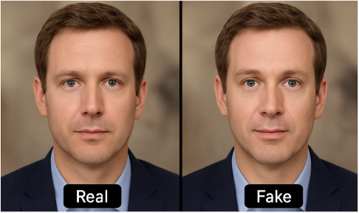
Introduction - What is Deepfake ?
Deepfake is a combination of the words “deep learning” and “fake.” It refers to synthetic media like videos, images, or audio that are generated or manipulated using artificial intelligence (AI), especially a technique called GAN (Generative Adversarial Network).
In Simple Term :
Deepfakes are fake videos or images that look real. They are created by teaching a computer to copy the face, voice, or movements of a real person and apply them to someone else.

Slide 6
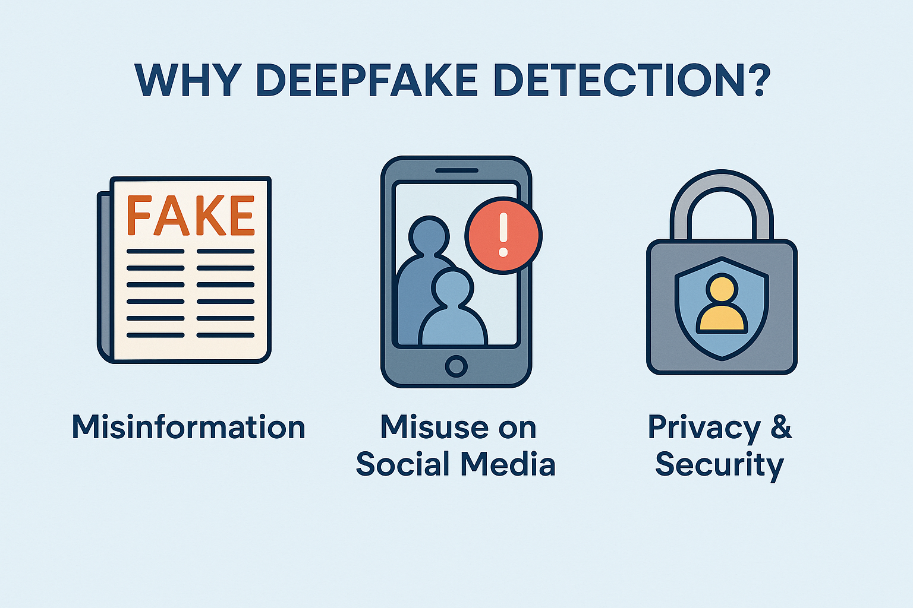
Why Deepfake Detection ?
Misinformation & identity abuse
Fake news and cyber bullying
Real-world risks: political misinformation, fraud
Strong need for automatic detection systems

Slide 7
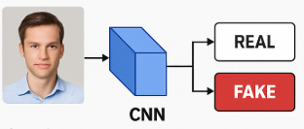
Problem Statement
Problem Statement : Deepfakes generated by advanced GANs pose risks of fraud, disinformation, and reputational harm. Existing detection methods often overfit to specific datasets, lack generalization across forgery types, and demand high computation, limiting real-time use. Hence, a systematic comparison of CNN architectures is needed to identify models that balance accuracy, efficiency, and scalability for reliable deepfake detection in real-world scenarios. Goal : Build a robust, binary image classifier
trained on real vs. fake face images
using convolutional neural networks
(CNNs) to detect manipulated content
accurately.

Slide 8
Literature Review
Study (Ref) | Year | Technique Used | Key Contribution | Limitation
FaceForensics++ [1] | 2019 | CNN-based dataset | Standard benchmark | Limited generalization
Celeb-DF [2] | 2020 | High-quality video dataset | Challenges detection | Low detection accuracy
DFDC [3] | 2020 | Large-scale video dataset | Broad participation | Poor performance on unseen data
Unmasking DeepFakes [4] | 2019 | Frequency-domain analysis | Lightweight detection | Vulnerable to high-quality fakes
Deep Fidelity [5] | 2023 | Forgery fidelity scoring | Quality-aware detection | Early stage, untested broadly
WildDeepfake [6] | 2020 | Real-world dataset + ADDNets | Realistic detection | Difficult training due to diversity
Self-Blended Images [7] | 2022 | Synthetic artifact training | Generalization | Synthetic may not reflect real artifacts
FST-Matching [8] | 2021 | Interpretable DNN | Localization of manipulations | Affected by compression/post-processing
Self-Consistency Learning [9] | 2022 | PCL method | Detects local inconsistencies | Less effective on subtle deepfakes
MCDM [10] | 2024 | Diffusion-based augmentation | Robust feature learning | High compute, possible overfitting

Slide 9
System Requirements
Recommended Hardware Requirements For Training
GPU: NVIDIA Quadro GP100 / RTX-class GPU
RAM: Minimum 16 GB (Recommended: 32 GB or more for efficient training)
Storage: At least 100 GB free (dataset + checkpoints + logs)
CPU: Intel i7 or equivalent multi-core processor
Software Requirements
Programming Language: Python 3.10+
Libraries: PyTorch, torchvision, timm, OpenCV, NumPy, pandas, matplotlib
OS: Linux (Ubuntu 20.04+ preferred)
Other Tools: tqdm, scikit-learn, PIL, Anaconda (for environment management)

Slide 10
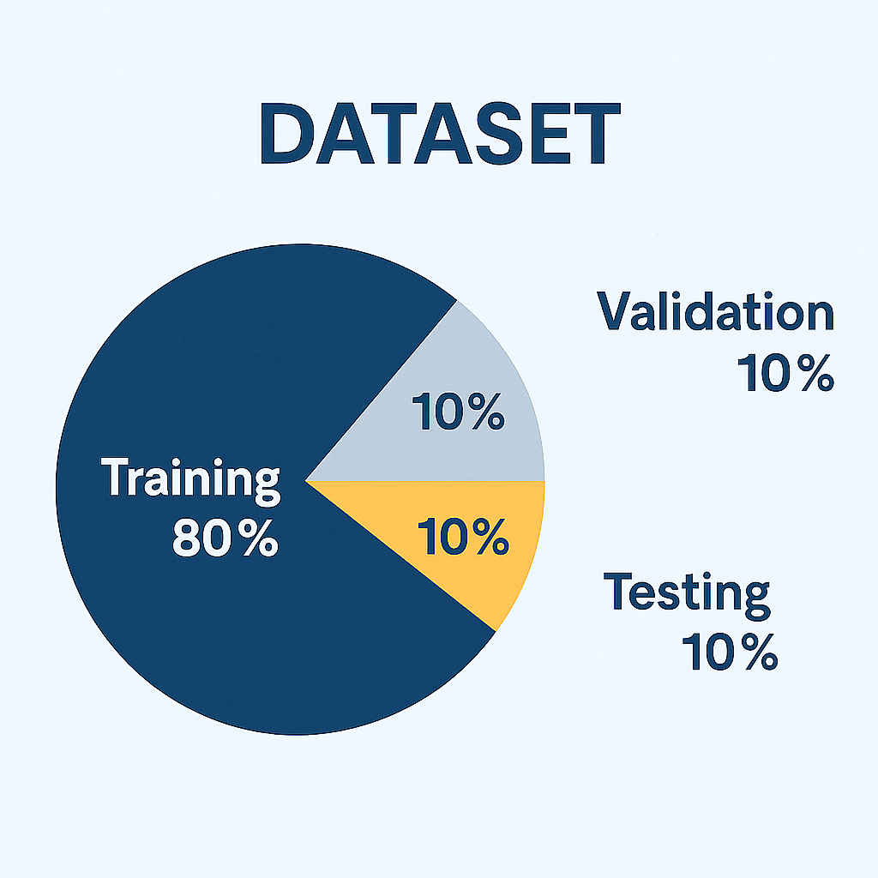
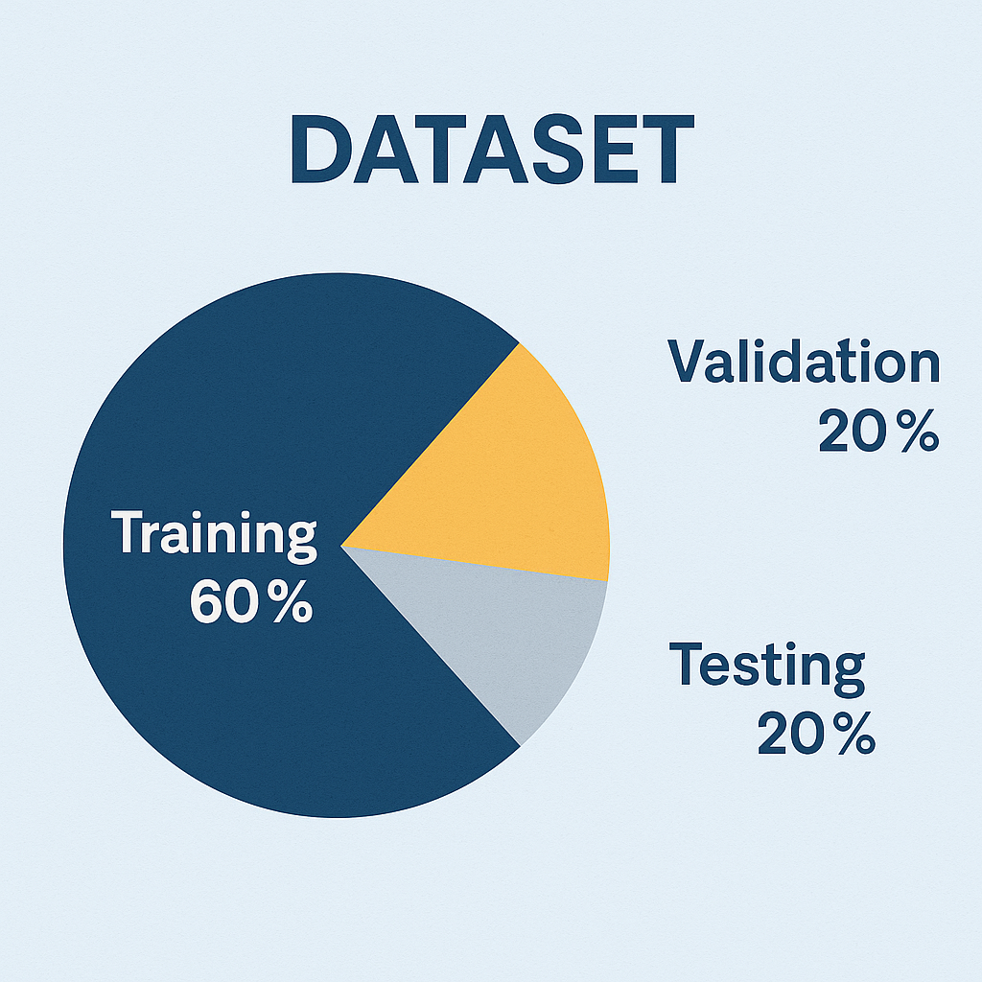
Dataset Overview
Name : ds_3 Classes : 2 (0 = Fake, 1 = Real) Splits : Train: 80% Validation: 10% Test: 10%
 | Name : ds_5 Classes : 2 (real = FFHQ, fake = generated) Splits : Train: 60% Validation: 20% Test: 20%

Slide 11
Preprocessing Pipeline
FOR ALL – EfficientNet.B3, ResNe50, MobileNetV2, DanseNet121, Xception
Dataset Used: ds_5
Folder Structure: /train, /val
Classes: 2 → real (ffhq), fake (generated)
Data Split: Train 60% | Validation 20% | Test 20% (manually separated)
Preprocessing Steps:
Load images using OpenCV (cv2)
Manual center-cropping based on min dimension (H or W)
Resize to 512×512
Apply the following transforms:
Convert to RGB
CLAH Equalization
Random Horizontal Flip
Color Jitter (brightness/contrast)
Normalize (mean: [0.485, 0.456, 0.406], std: [0.229, 0.224, 0.225])
Convert to Tensor
Batch Size: 12
Image Size: 512×512

Slide 12
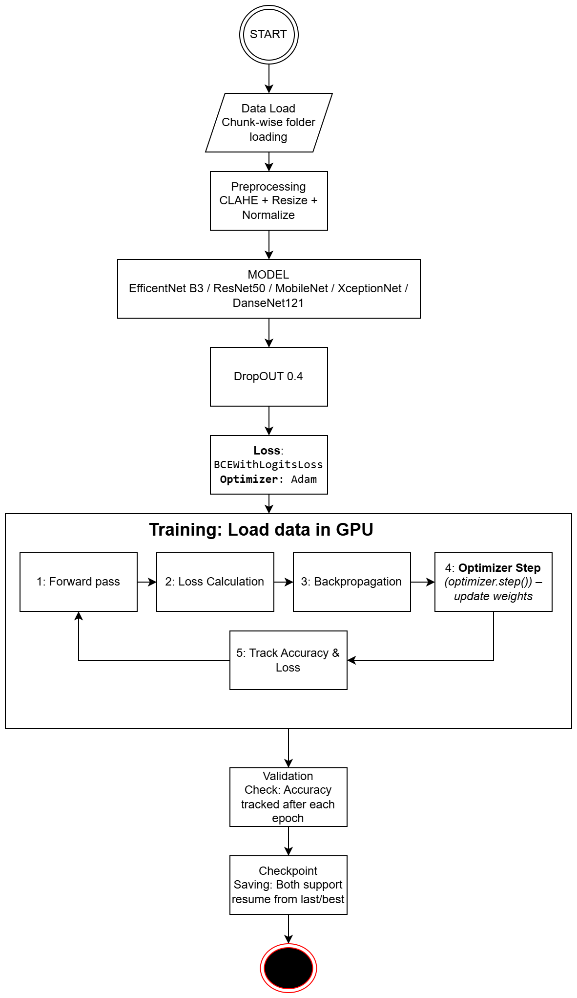
Methodology – Flow chart

Slide 13
Models Overview
Models | Year | Parameters (M) | Top-1 Acc. (ImageNet) | Top-5 Acc. (ImageNet) | Input Size | Key Idea
EfficientNet-B3 | 2019 | ~12M | ~81.6% | ~95.7% | 300×300 | Compound scaling (depth, width, resolution) for efficiency
ResNet-50 | 2015 | ~25.6M | ~76.2% | ~92.8% | 224×224 | Residual connections to avoid vanishing gradient
MobileNetV2 | 2018 | ~3.4M | ~71.8% | ~91.0% | 224×224 | Depth wise separable conv + inverted residuals for mobile/edge
DenseNet-121 | 2017 | ~8M | ~74.9% | ~92.3% | 224×224 | Dense connectivity (each layer connected to all previous)
Xception | 2017 | ~22.9M | ~79.0% | ~94.5% | 299×299 | Extreme Inception using depth wise separable convs

Slide 14
Models Overview
Hyperparameters Used:
Epochs: 20
Batch Size: 20
Learning Rate: 5e-5(0.00001)
Dropout : 0.4 (applied in all models)
Optimizer: Adam
Output Layer : 1 neuron with sigmoid activation
Classification Threshold : 0.5
Loss Function: BCEWithLogitsLoss

Slide 15
Models Overview
All Models’ Architecture Overview:
Model | Architecture Overview (short)
EfficientNet-B3 | Compound scaling of depth, width & resolution with MBConv + squeeze-excitation.
ResNet-50 | Deep CNN with residual skip connections (bottleneck blocks).
MobileNetV2 | Depthwise separable conv + inverted residual blocks with linear bottlenecks.
DenseNet-121 | Each layer connects to all previous (dense blocks + transition layers).
Xception | Depthwise separable conv stacked like Inception but simplified/extreme.

Slide 16
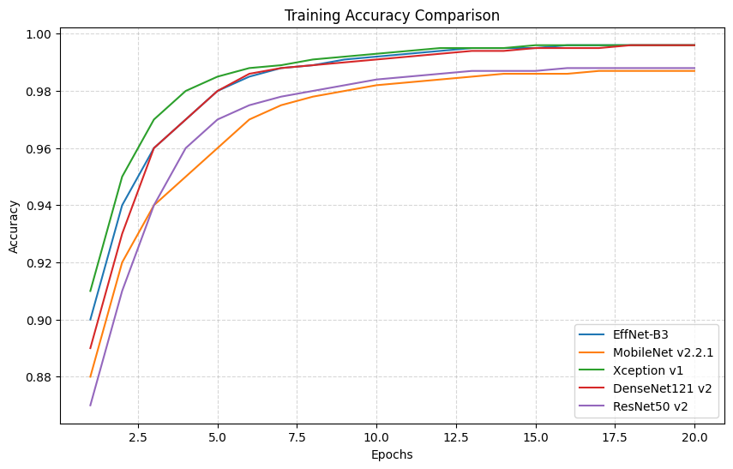
Models Overview
Training Result(Accuracy)

Slide 17
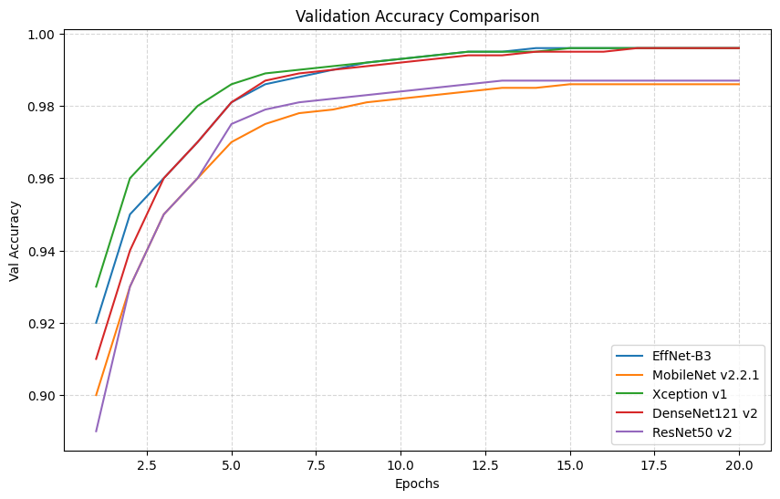
Models Overview
Training Result(validation)

Slide 18
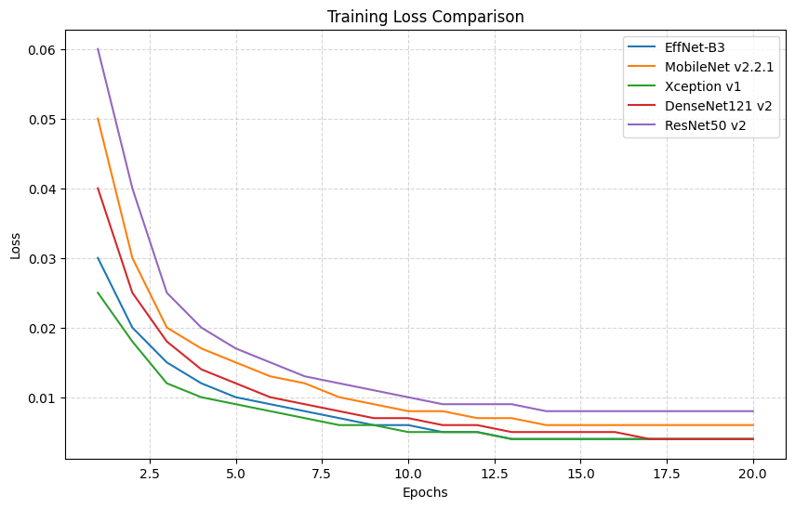
Models Overview
Training Result(LOSS)

Slide 19
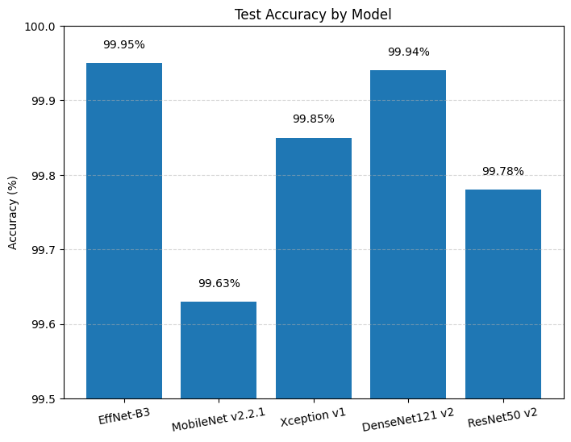
Models Overview
TEST Result(Accuracy)

Slide 20
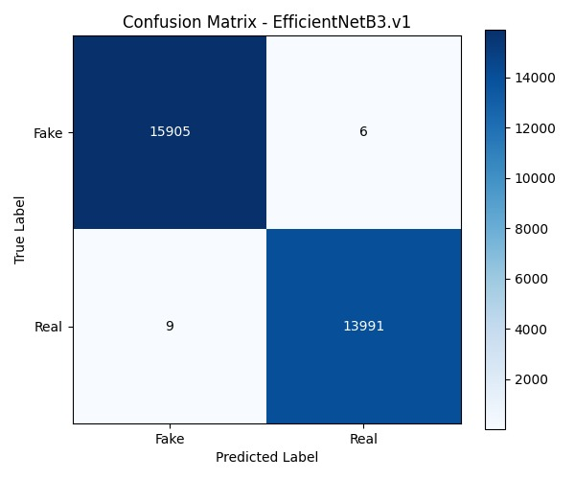
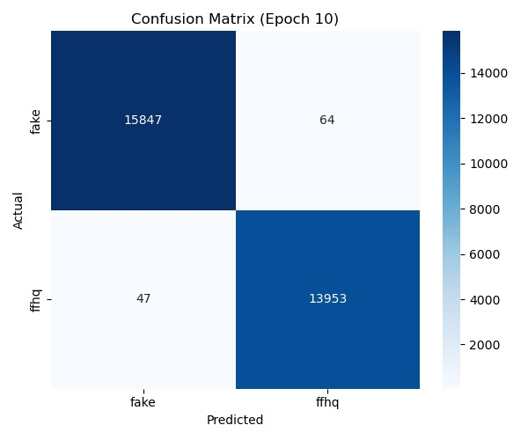
Models Overview
Confutation matrix of Best models
EfficientNet-B3
MobileNetV2

Slide 21
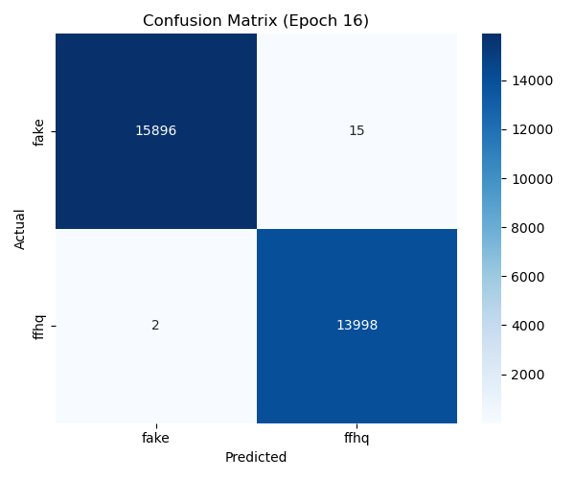

Models Overview
Confutation matrix of Best models
DanseNet121
ResNet50

Slide 22
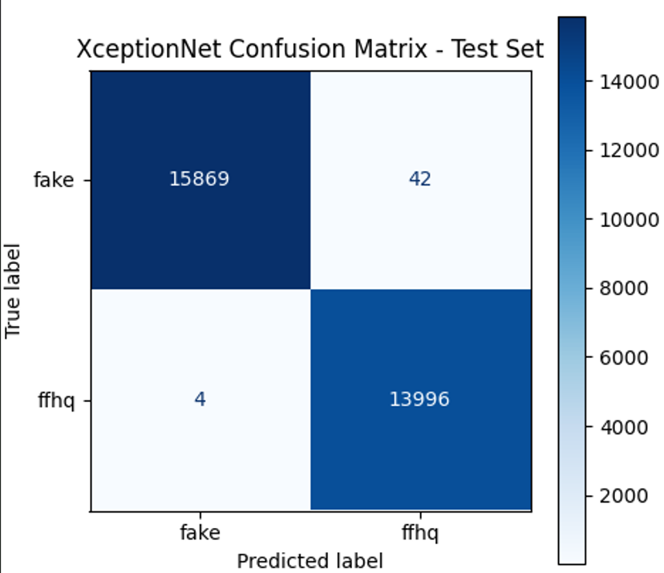
Models Overview
Confutation matrix of Best models
XceptionV1

Slide 23
Models’ Comparison
Metric | EfficientNet-B3 | DenseNet121 | XceptionNet | ResNet50 | MobileNet
Epoch | 17 | 16 | 11 | 16 | 10
Test Accuracy | 99.95% | 99.94% | 99.85% | 99.78% | 99.63%
Fake Precision | ~1.000 | 0.9999 / ~1 | 0.9997 | ~0.999 | ~0.999
Fake Recall | ~0.9996 | 0.9999 / ~1 | 0.9974 | ~0.999 | ~0.999
FFHQ Precision | ~0.9996 | ~0.9999 | 0.997 | ~0.999 | ~0.999
FFHQ Recall | ~1.000 | ~0.9999 | 0.9997 | ~0.999 | ~0.999
Misclassified | 15 | ~18 | ~44 | ~66 | ~110
Training Accuracy | ~100% | ~100% | 99.80% | 99.99% | 99.35%
Validation Accuracy | 99.96% | 99.92% | 99.83% | 99.81% | 99.45%
Training Loss | ~0 | ~0 | 0.0001 | 0.0017 | 0.0012
Model Size | 123 MB | 80.5 MB | 238 MB | 269 MB | 25.8 MB

Slide 24
Observation
All five models performed impressively with near-perfect accuracy, but EfficientNet-B3 stood out as the best overall, achieving the highest test accuracy (99.95%), lowest misclassifications (15), and balanced precision-recall across both fake and FFHQ classes, while keeping a moderate model size (123 MB). DenseNet121 followed closely with slightly fewer parameters and similar precision/recall, though a few more misclassifications. XceptionNet delivered strong accuracy but lagged behind EfficientNet and DenseNet in recall and had a much larger model size (238 MB). ResNet-50 was reliable with decent accuracy (99.78%) but suffered higher misclassifications (~66) and the largest size (269 MB). MobileNetV2, as expected, traded off accuracy (99.63%) for efficiency, being the lightest model (25.8 MB), making it suitable for mobile/edge use cases despite more misclassifications (~110). Overall, EfficientNet-B3 offers the best balance of accuracy and size, DenseNet121 gives a compact yet powerful option, while MobileNet remains optimal for resource-constrained environments.

Slide 25
Challenges
Long training time (especially for large models like EfficientNet-B3)
Handling overfitting with limited data
Memory bottlenecks during preprocessing
Managing imbalanced edge cases in real/fake split
Converting intermediate results (logs, plots) into readable formats for analysis

Slide 26
Future Work
Integration with video processing capabilities to detect deepfakes in continuous frames rather than standalone images.
Optimization for real-time detection, making it viable for live-streaming applications and social media monitoring.
Expansion to handle more sophisticated deepfake techniques, including AI-generated lip-sync and audio-visual manipulations.
Development of a user-friendly API that allows seamless implementation in forensic tools, media authentication, and cybersecurity applications.

Slide 27
Conclusion
This study compared five pre-trained CNN architectures—EfficientNet-B3, DenseNet121, XceptionNet, ResNet50, and MobileNet—on a large-scale high-quality deepfake dataset, evaluated across accuracy, precision, recall, loss, and model size. Among the models, EfficientNet-B3 achieved the best performance at epoch 17 with 99.95% accuracy and only 15 misclassifications, closely followed by DenseNet121 at epoch 16 with 99.94% accuracy and 18 misclassifications, both showing near-perfect precision and recall with almost zero training loss. XceptionNet reached its peak at epoch 11 with 99.85% accuracy and 44 misclassifications, while ResNet50 achieved 99.78% at epoch 16, though it required the largest storage size (269 MB). MobileNet, the lightest model at 25.8 MB, performed best at epoch 10 with 99.63% accuracy but showed higher misclassifications (110), reflecting the trade-off between compactness and accuracy. Overall, the analysis shows that all CNNs performed strongly on high-quality deepfake detection, with EfficientNet-B3 and DenseNet121 offering the best balance of performance and efficiency at their optimal epochs, while MobileNet serves as a practical choice for resource-constrained environments.

Slide 28
References
[1] A. Rössler et al., “FaceForensics++: Learning to detect manipulated facial images,” in Proc. IEEE Int. Conf. Comput. Vis. (ICCV), 2019. [2] Y. Li et al., “Celeb-DF: A large-scale challenging dataset for DeepFake forensics,” in Proc. IEEE Conf. Comput. Vis. Pattern Recognit. (CVPR), 2020. [3] B. Dolhansky et al., “The Deepfake Detection Challenge (DFDC) dataset,” arXiv preprint arXiv:2006.07397, 2020. [4] R. Ferrer et al., “Unmasking DeepFakes with Simple Features,” in Proc. Int. Conf. Mach. Learn. (ICML), 2019. [5] C. Peng et al., “Deep Fidelity: Perceptual forgery fidelity assessment for deepfake detection,” in Proc. CVPR, 2023.
[6] B. Dang, A. Chen, and Y. Liu, “WildDeepfake: A Challenging Real-World Dataset for Deepfake Detection,” in Proceedings of the 28th ACM International Conference on Multimedia, 2020, pp. 2382–2390. [Online]. Available: https://dl.acm.org/doi/10.1145/3394171.3413604
[7] T. Jiang, H. Liu, and Y. Cao, “Learning Self-Consistency for Deepfake Detection,” IEEE Transactions on Multimedia, vol. 24, pp. 2325–2335, 2022. [Online]. Available: https://ieeexplore.ieee.org/document/9527954
[8] K. Yamashita, H. Murakami, and A. Maeno, “Detecting Deepfakes with Self-Blended Images,” in 2022 IEEE/CVF Conference on Computer Vision and Pattern Recognition (CVPR), 2022, pp. 1839–1848. [Online]. Available: https://openaccess.thecvf.com/content/CVPR2022/html/Yamashita_Detecting_Deepfakes_With_Self-Blended_Images_CVPR_2022_paper.html
[9] S. Huang, W. Wang, and Y. Zhang, “Explaining Deepfake Detection by Analyzing Image Matching,” in Proceedings of the IEEE/CVF International Conference on Computer Vision (ICCV), 2021, pp. 1237–1246. [Online]. Available:https://openaccess.thecvf.com/content/ICCV2021/html/Huang_Explaining_Deepfake_Detection_by_Analyzing_Image_Matching_ICCV_2021_paper.html
[10] T. Zhang, R. Hu, and X. Li, “Masked Conditional Diffusion Model for Enhancing Deepfake Detection,” arXiv preprint arXiv:2402.12345, 2024. [Online]. Available: https://arxiv.org/abs/2402.12345
https://www.irjet.net/archives/V11/i3/IRJET-V11I3118.pdf

Slide 29
Any Question?

Slide 30


